Slide 1



Slide 2

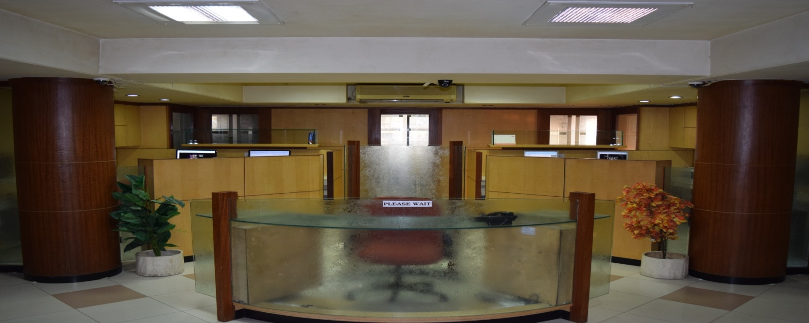
ABOUT US
SAPIENT TECHNO CONSULTANTS is a fast growing multi disciplinary consulting engineering firm based at Surat and having offices at Surat and Ahmedabad. The company, formed by a group of technocrats, specializes in providing design, engineering and project management consultancy services in following areas of interest:
Water & Waste Water Management
Water Recycle & Re-use
Environmental engineering
Infrastructure - Water & Sewerage Network, Industrial Parks / SEZ, etc.
Civil Engineering – Land Survey, Geo-technical investigations, etc.
Bio-gas based power generation
Electrical Power Distribution (LT/MV)
Electrical Sub Stations (up to 66KV)
Instrumentation, Automation and SCADA Solutions
Water Audit & Leak Detection Services
Our expertise & experience in design and handling various process technologies include the most basic to the advanced state-of-the-art processes as under:
Sewage Treatment
Conventional Activated Sludge Process (CASP)
Up flow Anaerobic Sludge Blanket (UASB) Process
Sequential Batch Reactor (SBR) Process
Extended Aeration (ASP) Process
Moving Bio Batch Reactor (MBBR) Process
A₂O Process(Nutrient Removal with Biological & Tertiary Treatment)

Slide 3

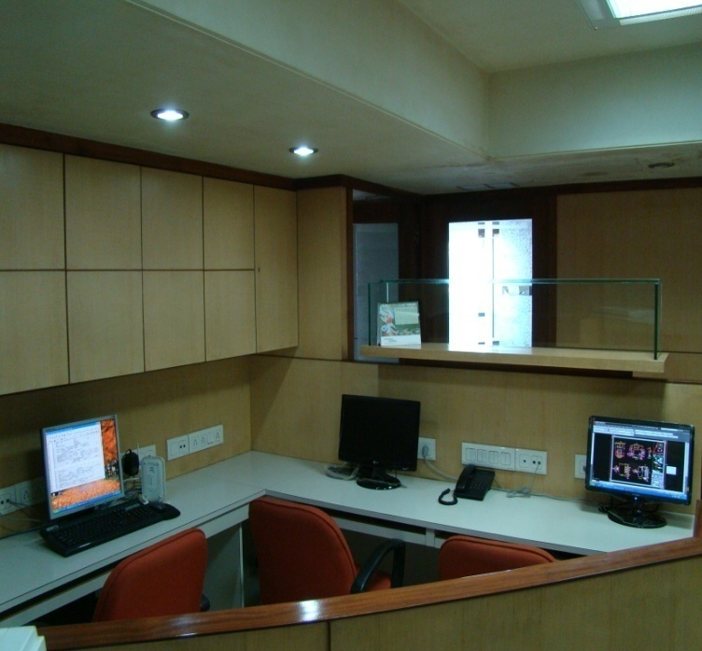
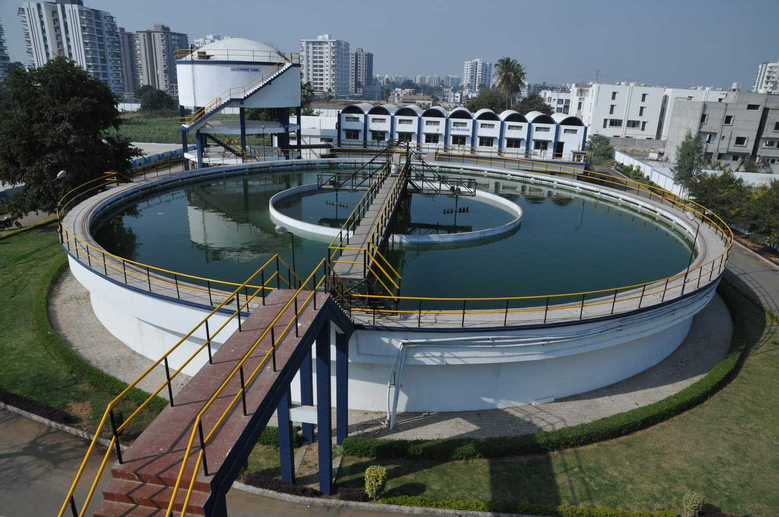
Tertiary Treatment
PSF / ACF
Membrane Filtration (UF / MBR)
RO System
Water Treatment
Clariflocculator
Tube Settler / Lamella Clarifier
Reactor Clarifier
Rapid Gravity sand Filtration
In short, we can provide comprehensive multi disciplinary consultancy for a project right from conceptualization and technical feasibility to project planning, survey and investigation, basic design & cost estimation, detailed design & engineering, contract documents, construction supervision, Inspection and quality control, project management, and commissioning of project - All under one roof.
Registration / Empanelment DETAILS
Surat Municipal Corporation
Vadodara Municipal Corporation
Guwahati Metropolitan Development Authority
Odisha Urban Infrastructure Development Authority
Ahmedabad Municipal Corporation
Gujarat Infrastructure Development Board
Gujarat Rural Housing Board
Gujarat Police Housing Board
World Bank

Slide 4

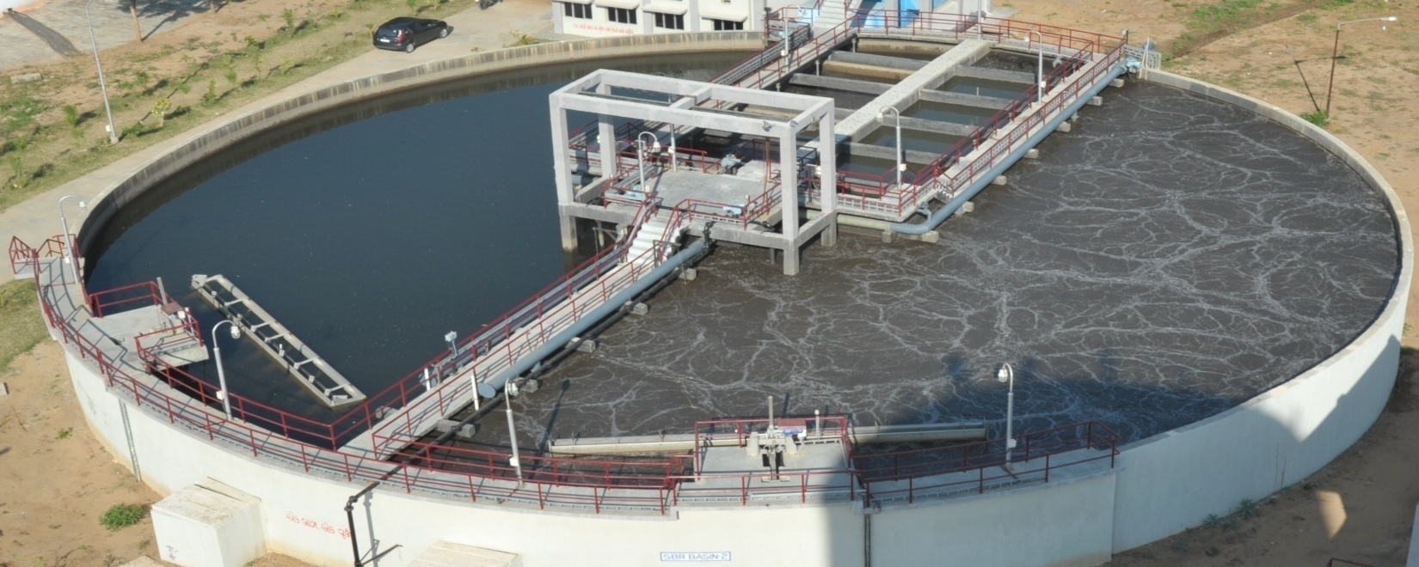
SIGNATURE PROJECTS:
240 MLD Sewage Treatment Plant at Vasna , Ahmedabad for AUDA
Scope of Work:
Preparation of DPR including basic design & cost estimates, tender documents, bid evaluation, approval of working drawings and project management services including site supervision, third party inspection, etc.
Project Details:
Conventional Activated Sludge Process, PLC / SCADA based process control automation
56 MLD Sewage Treatment Plant at Bapudham, Ghaziabad for GDA.
Scope of Work:
Preparation of basic engineering (Process & Hydraulic Design), Preparation of G.A drawings & detailed Engineering for Piping, Electro-Mechanical & Instrumentation works.
Project Details:
Sequential Batch Reactor Process, PLC / SCADA based process control automation
66 MLD Sewage Treatment Plant at Dindoli, Surat for SMC
Scope of Work:
Preparation of DPR including basic design & cost estimates, tender documents.
Project Details:
Conventional Activated Sludge Process + Bio Gas based Power generation
43 MLD Sewage Treatment Plant at Ataladra , Vadodara for VMC
Scope of Work:
Preparation of basic engineering (Process & Hydraulic Design), Preparation of G.A. drawings and detailed engineering for piping, Electro-Mechanical & Instrumentation works. Scope also includes Bio-gas based power plant.
Project Details:
UASB process followed by extended aeration + Bio-gas based power generation

Slide 5
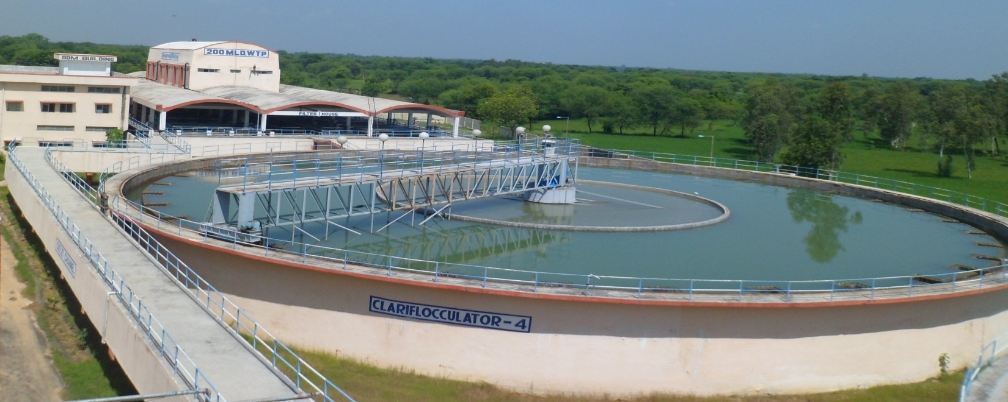
200 MLD Water Treatment Plant at Raska, Ahmedabad for AMC
Scope of Work:
Preparation of basic design, tender documents, bid evaluation for award of work, approval of detailed design and working drawings.
Project Details:
Raw water sump & pump house along with Vertical Turbine type pumping machinery, Conventional water treatment process consisting of Clariflocculator + Rapid gravity sand filter.
90 MLD Water Treatment Plant at Kosad & 32 MLD at Varachha for North zone, SMC
Scope of Work:
preparation of DPR including basic design & cost estimates, approval from Govt. of India under JnNURM, preparation of tender and approval of drawings.
Project Details:
Conventional water treatment process consisting of Clariflocculator + Rapid gravity sand filter.
PFBS Lift project to meet Drinking Water Demand Based on Indira Gandhi Main Canal (IGMC) of PHED, Rajasthan.
Scope of Work:
Preparation of basic engineering (Process and Hydraulic Design) , Preparation of G.A drawings and detailed Engineering for Piping, Electro-Mechanical & Instrumentation works
Project details:
Raw Water Pump House with 6.6KV HT Vertical Turbine Pumps at HW-1, 2 & 3
119 MLD WTP at Biliya, 3.1 MLD WTP at Ajasar, and 3.2 MLD WTP at Nachana
(Conventional water treatment process: Clariflocculator + Rapid Gravity sand filter with PLC/SCADA based process control automation)

Slide 6
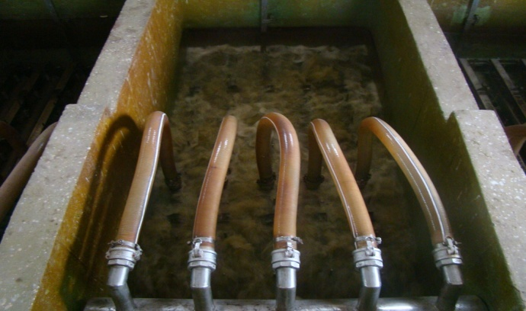
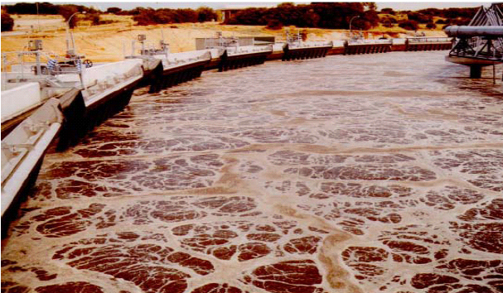
66.40 MLD ZLD for recycling of treated water to Member Industries for Pali Water Pollution Control, Treatment & Research Foundation (PWPCTRF)
Scope of Work:
Preparation of DPR including Cost Estimation, Bid Document, Bid Evaluation, Execution design & drawings approval, and supervision of work during execution incl. PMC Services.
Treatment process:
Membrane Filtration (UF + RO), Multiple Effect Evaporator & Land Fill Site Development
(Sludge + RO Reject Handling)
6 MLD ZLD for recycling of treated water to Member Industries for Balotra Water Pollution Control & Research Foundation Trust (BWPC&RFT)
Scope of Work:
Preparing Tender Document, Bid Evaluation and approval of execution design & drawings
Treatment process:
Membrane Filtration (UF + RO), Solar Evaporation Ponds
10 MLD Capacity Effluent Treatment Plant for water recycling at Fairdeal Textile Park
Scope of Work:
Preparation of DPR including Cost Estimation, Tender Document, Bid Evaluation and detailed engineering including release of working drawings for execution
Treatment process:
SBR based CETP followed by Membrane Filtration (UF + RO)
12 MLD Effluent Treatment Plant for Pali Water Pollution Control, Treatment and research Foundation (PWPCTRF)
Scope of Work:
Preparation of basic engineering (Process & Hydraulic Design), G.A. drawings and detailed Engineering for Piping, Electro-Mechanical, & Instrumentation works.
Treatment process:
Physico-Chemical followed by Sequential Batch Reactor (SBR) & Tertiary Treatment

Slide 7
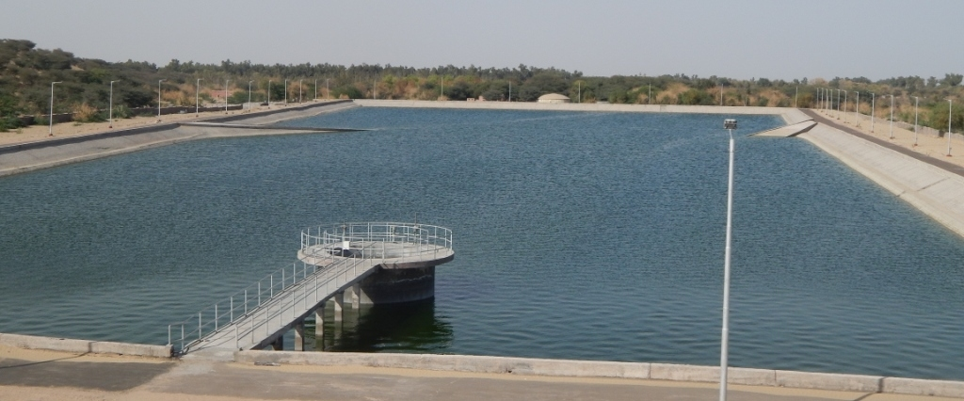
Electro-Mech. Works for Intake well (for New East & South East area) and 7 nos. Water distribution stations for SMC, Surat
Scope of Work:
Preparation of basic design & DPR and obtaining approval from Govt. of India under JnNURM.
Up gradation of sewerage system at Bhavnagar for M/s. Bhavnagar Municipal Corporation.
Scope of Work:
Preparation of DPR including basic design & cost estimates, tender documents & bid evaluation.
Project details:
The project components comprise of:
Sewerage Network, app.86 km length, 200mm to 1600 mm dia. RCC pipes.
Augmentation of 4 nos. sewage pumping stations.
Rising main, 600 m to 800 mm dia. DI pipes.
30 MLD capacity UASB Reactor based sewage Treatment plant at Kumbharwada.
553 MLD capacity Water Supply Scheme from Dhanki to Navada, NC-26 Package of GWIL under Sardar Sarovar Canal based Drinking Water Supply Project
Scope of Work:
Design & Detailed Engineering for Electrical, Instrumentation & Automation works for pump house.
Project details:
66KV Switch yard with 2 nos. 7.5MVA 66/6.9KV Power Transformers
6.6 kV HT Vertical Turbine type pumping machinery (6W + 2S, 1000KW motor rating)
Instrumentation along with PLC/SCADA based monitoring system

Slide 8




















SURAT OFFICE:
A-7001, Ascon Plaza (Office Complex),
B/h Bhulka Bhavan School,
Anand Mahal Road, Adajan,
Surat – 395009
Tel : +91 - 261-273 8052
Fax : +91 - 261-273 8053
E-mail : sapient_srt@sapient.net.in
AHMEDABAD OFFICE:
701, Rembrandt,
Opp. Associated Petrol Pump,
C.G. Road,
Ahmedabad – 380 006
Tel : +91 - 79-2642 2104/79-66052933
Fax : +91 - 79-2642 2105
E-mail : sapent_ahd@sapient.net.in

